Slide 1
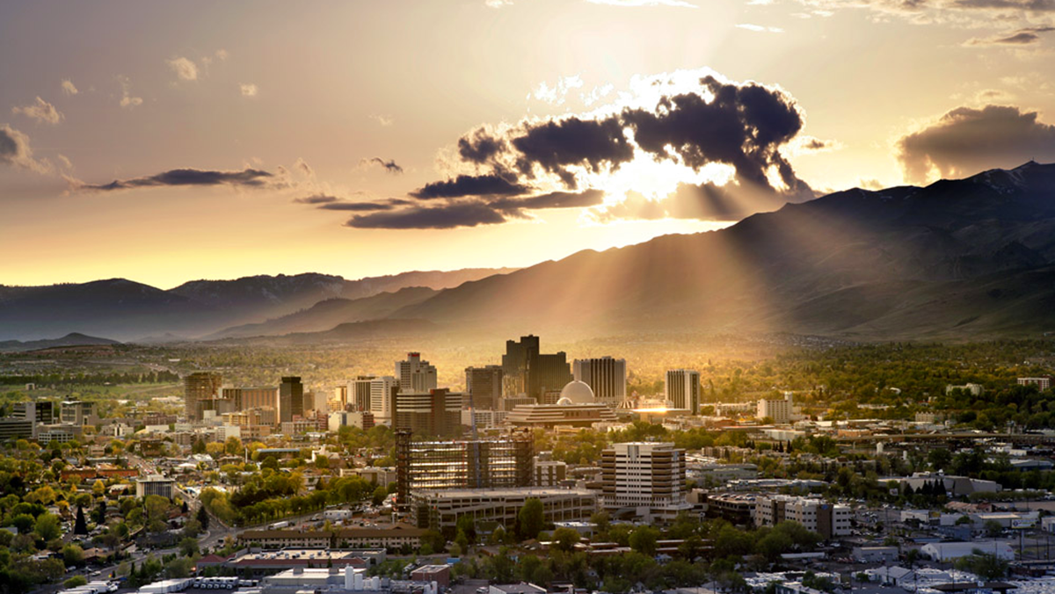

March 3, 2020
Finance Department
City of Reno
Deborah Lauchner, Finance Director

Slide 2
March 3, 2020 Agenda
City of Reno Strategic Plan
Budget Development Overview
Additional Funding Requests
10-Year Forecast
Capital Improvement Plan (CIP)
Debt Overview
Next Steps
2

Slide 3
City of Reno Strategic Plan for 2020-2025
Public Safety
Identify New Revenues
Homelessness
Fiscal Sustainability
Affordable Housing
Downtown Action Plan
Homelessness
Revitalization
Public Safety
Parks
Partnerships
Flood Mitigation
Development
3
Notes:
Manager budget was derived strategically from known Council Priorities

Slide 4
Budget Development Overview

Slide 5
Budget Guiding Principles
Structural Budget Deficit Elimination - balanced budget approach
General Fund Reserves - maintain level of between 8.3% and 25%
Stabilization Fund - maintain to mitigate the effects of a natural disaster
Allocation of New Revenue Sources – 1) Stabilization, 2) OPEB, 3) W/C, 4) Capital, 5) Council priorities
Budget Forecasting – 5-year forecast
Commit to Maintaining Delivery of Core Services – prioritize expenditures based on core services
Commit to Improve Service Delivery and Reduce Duplication – efficiency improvements to eliminate service duplication
Use of One-Time Resources – one-time resources to one-time expenses
Establish Cost Recovery for Identified Programs and Services – 100% cost recovery
5

Slide 6
Budget Guiding Principles (continued)
Include Resources Required to Maintain and Operate Capital Improvements and New Programs – plan for ongoing operational and replacement expenses
Fully Fund Annual Contributions to OPEB Trust – fully fund annual contribution to OPEB trust
Public Works Capital Project Fund – capital infrastructure and maintenance plan
Essential Capital Assets – maintain inventory of capital assets
Year-end Fund Balance by Department – CM authorization for use of prior year savings
Maximizing Regional Revenues – advocate for regionally generated revenues for City needs
Future Planning –avoid balancing current year budget at expense of future budgets
Revenue Allocation – avoid targeting revenues for specific programs
6

Slide 7
FY 20/21 Budget Development
  Base Budget
    Includes current staffing levels
    Includes CBA factors, PERS, health benefits
    Services and Supplies
      Increases for contract services
  Additional funding requests
    Not included in base budget
7

Slide 8
FY 20/21 Budget Development
  Additional Considerations:
  Fully fund annual contribution to OPEB trust
  Increase annual funding to Workers Comp Fund 10%, Risk Fund 10%, & Fleet Fund 20%
  Maintain a General Fund reserve level of between 8.3% and 16%
  Develop and maintain a 10-year budget forecast
8

Slide 9
FY 20/21 Budget Development
Projected revenues are based on assumed growth over actual revenues received in prior years.
These are analyzed at mid-year using trend analysis year over year and month over month.
For Sales Tax and Property Tax, we compare our projections with projections from the Department of Taxation and other local agencies. The included preliminary projections for FY20/21 include a 5.5% increase for Property Taxes and a 4.0% increase for CTAX.
For program revenues, we collaborate with the departments and come to consensus.
Expenditures come from the departments and are reviewed to ensure they meet the budget instructions.
9

Slide 10
FY 20/21 Budget Development
Property Taxes are relatively stable with about a 2 year lag to economic conditions
NRS 361.4535 requires the Department of Taxation to provide a projection of the property tax revenue for the upcoming fiscal year on or before March 25th
The General Tax Cap is calculated by taking the greater of the moving average growth rate or twice the CPI, up to a maximum of 8%
The Residential Tax Cap is 3% unless the General Tax Cap is less than 3%. If the General Tax Cap is less than 3% then the Residential Cap must equal the General Tax Cap
Included preliminary projections for FY20/21 include a 5.5% increase for Property Tax
10

Slide 11
FY 20/21 Budget Development
FY | Residential | Commercial | 10yr AV | CPI | 2x CPI
2012 | 3.0% | 4.0% | 4.0% | 1.6% | 3.2%
2013 | 3.0% | 6.4% | 2.7% | 3.2% | 6.4%
2014 | 3.0% | 4.2% | 1.7% | 2.1% | 4.2%
2015 | 3.0% | 3.0% | 1.3% | 1.5% | 3.0%
2016 | 3.0% | 3.2% | 0.6% | 1.6% | 3.2%
2017 | 0.2% | 0.2% | 0.0% | 0.1% | 0.2%
2018 | 2.6% | 2.6% | -0.7% | 1.3% | 2.6%
2019 | 3.0% | 4.2% | 1.2% | 2.1% | 4.2%
2020 | 3.0% | 4.8% | 3.0% | 2.4% | 4.8%
2021 | 3.0% | 4.9% | 4.9% | 1.8% | 3.6%
Tax Bill Cap Formula:
Commercial
The LESSER of 8%, OR:
The GREATER of 2x CPI OR Average 10yr AV growth rate
Owner Occupied Residential
The LESSER of 3%, OR the Commercial Cap
11

Slide 12
Property Tax History

Slide 13
FY 20/21 Budget Development
CTax is our most volatile revenue source reacting almost immediately to economic conditions
Preliminary CTax projections are provided by the Department of Taxation on February 15th and final projections are provided by March 15th
CTax has shown improvement over the last 12 to 18 months, however we still believe it is appropriate to continue to take a conservative approach
Statewide CTax has been projected by the Department of Taxation to show a growth of 5.54% for FY 2019-2020 and a growth of 3.36% for Fiscal Year 2020-2021
Included preliminary projections for FY20/21 include a 4.0% increase for CTAX
13

Slide 14
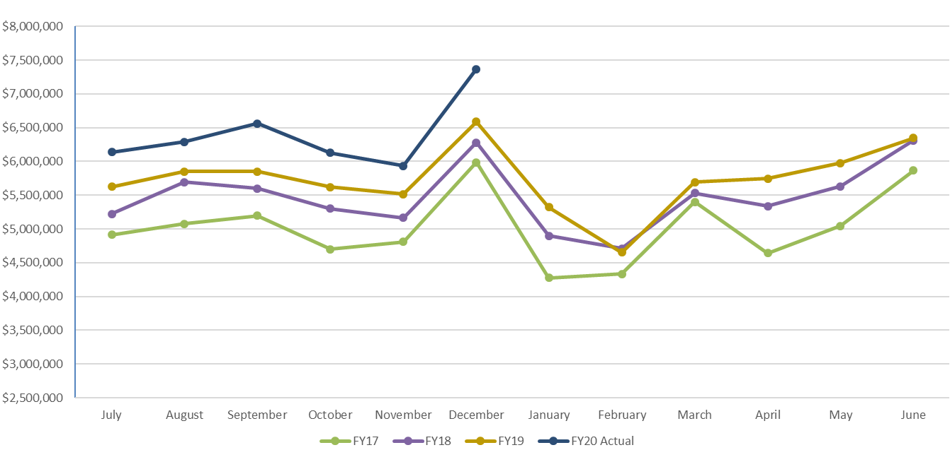
CTAX History
14

Slide 15
Property Tax & CTAX History

Slide 16
General Fund Major Revenues Projected FY 2019/20 & FY2020/21
16

Slide 17
General Fund Revenue Projections
17

Slide 18
General Fund Expenditure Projections
18

Slide 19
General Fund Summary
19

Slide 20
General Fund Balance History

Slide 21
Additional Funding Requests

Slide 22
Additional Funding Requests by Department
22

Slide 23
Additional Requested Positions by Department
23

Slide 24
10-Year Forecast

Slide 25
General Fund 10-Year Forecast
25

Slide 26
General Fund Balance 10-Year Forecast

Slide 27
General Fund 10-Year Forecast
27

Slide 28
Structural Budget Deficit
Projected

Slide 29
Structural Budget Deficit
Structural budget deficit
  Fund budgets using prior year unspent funds:
        Higher than anticipated revenues
        Unspent funds
        One-time funds
Structurally balanced budget likely achieved by FY22 if no additional staffing added
Preliminary budget projections for FY20/21 represent a status quo budget
29

Slide 30
CIP

Slide 31
Capital Improvement Plan by Fund
31

Slide 32
FY 20/21 General Capital Projects
32

Slide 33
Debt Overview

Slide 34
City of Reno & Redevelopment Agency
Fire Apparatus
Sewer Bonds
Public Safety Center
ReTRAC Refunding
34

Slide 35
Next Steps

Slide 36
Next Steps
FY19/20 Third Quarter Augmentations through March 2020
FY 20/21 Budget Development continues through May 2020
FY 20/21 Budget Workshops May 2020
FY 20/21 Budget Hearing and Adoption – May 20, 2020
FY19/20 Fourth Quarter Augmentations through June 2020 for year-end clean-up
36
Notes:
Manager budget was derived strategically from known Council Priorities

Slide 37
Questions?
Notes:
RDA 80000-82000

